Slide 1
One Returned To Give Thanks
LUKE 17:11-19

Slide 2
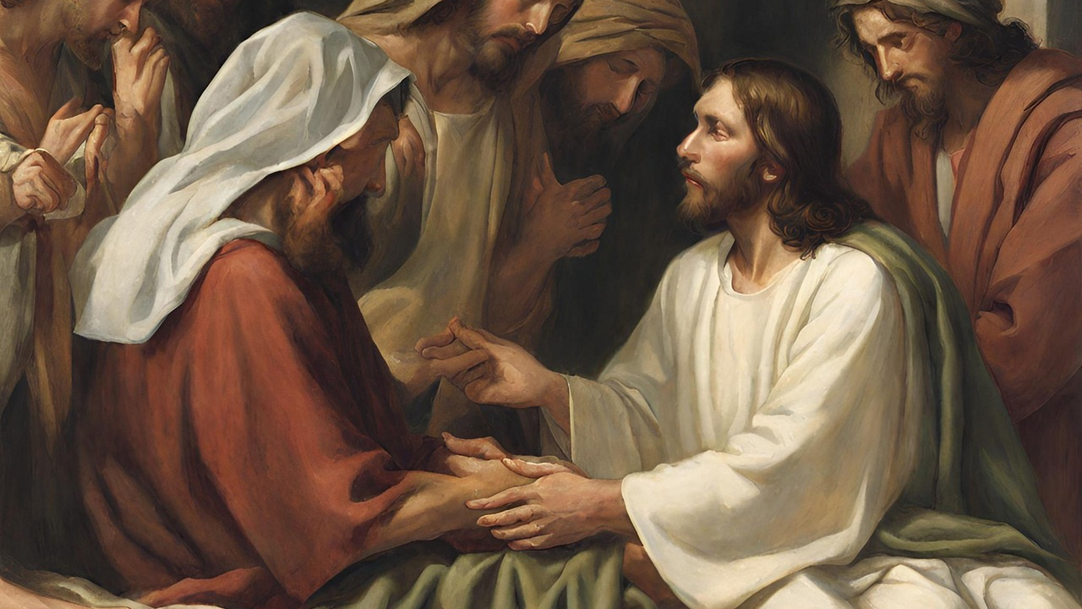

Slide 3
To the Lord our God belong mercy and forgiveness, though we have rebelled against Him. (Daniel 9:9)
In Him we have redemption through His blood, the forgiveness of sins, according to the riches of His grace… (Ephesians 1:7)

Slide 4
Leprosy frequently symbolizes sin.
It devastates a life like sin.
It is contagious like sin.
It grows progressively worse like sin.

Slide 5
The Lepers’ Condition
Then as He entered a certain village, there met Him ten men who were lepers, who stood afar off. (12)

Slide 6
The Leper’s Request
And they lifted up their voices and said, “Jesus, Master, have mercy on us!” (13b)

Slide 7
The Lepers’ Obedience and Healing
He said to them, “Go, show yourselves to the priests.” And so it was that as they went, they were cleansed (14a)

Slide 8
One Leper’s Return
And one of them, when he saw that he was healed, returned, and with a loud voice glorified God (15)

Slide 9
and fell down on his face at His feet, giving Him thanks. And he was a Samaritan. (16)
proskuneo (pros-koo-neh’-o). It is a verb meaning to go down on knees to, do obeisance to, worship.

Slide 10
The Leper’s Faith
Arise, go your way. Your faith
has made you well. (19)

Slide 11
BRINGING IT HOME where we live:
We have to wonder which group we would have been in, the nine or the one?
Most of all, do you have faith that Jesus can forgive your sins as well?

